Slide 1
Chapter 2
Introduction to Structured Query Language (SQL)

Slide 2
Learning Objectives
After completing this chapter, you will be able to:
  Retrieve specified columns of data from a database
  Join multiple tables in a single SQL query
  Restrict data retrievals to rows that match complex criteria
  Aggregate data across groups of rows
  Create subqueries to preprocess data for inclusion in other queries
  Identify and use a variety of SQL functions for string, numeric, and date manipulation
  Explain the key principles in crafting a SELECT query

Slide 3
Introduction to SQL (1 of 4)
Categories of SQL functions
  Data definition language (DDL)
  Data manipulation language (DML)
  Transaction control language (TCL)
  Data control language (DCL)
SQL is relatively easy to learn
  Nonprocedural language with basic command vocabulary set of less than 100 words
  Differences in SQL dialects are minor

Slide 4
Introduction to SQL (2 of 4)
Table 7.2 | SQL Data Definition Commands
Command or Option | Description | Covered
CREATE SCHEMA AUTHORIZATION | Creates a database schema | Chapter 8
CREATE TABLE | Creates a new table in the user’s database schema | Chapter 8
NOT NULL | Ensures that a column will not have null values | Chapter 8
UNIQUE | Ensures that a column will not have duplicate values | Chapter 8
PRIMARY KEY | Defines a primary key for a table | Chapter 8
FOREIGN KEY | Defines a foreign key for a table | Chapter 8
DEFAULT | Defines a default value for a column (when no value is given) | Chapter 8
CHECK | Validates data in an attribute | Chapter 8
CREATE INDEX | Creates an index for a table | Chapter 8
CREATE VIEW | Creates a dynamic subset of rows and columns from one or more tables | Chapter 8
ALTER TABLE | Modifies a table’s definition (adds, modifies, or deletes attributes or constraints) | Chapter 8
CREATE TABLE AS | Creates a new table based on a query in the user’s database schema | Chapter 8
DROP TABLE | Permanently deletes a table (and its data) | Chapter 8
DROP INDEX | Permanently deletes an index | Chapter 8
DROP VIEW | Permanently deletes a view | Chapter 8

Slide 5
Introduction to SQL (3 of 4)
Table 7.3 | Other SQL Commands
Command or Option | Description | Covered
Transaction Control Language
COMMIT | Permanently saves data changes | Chapter 8
ROLLBACK | Restores data to its original values | Chapter 8
Data Control Language
GRANT | Gives a user permission to take a system action or access a data object | Chapter 16
REVOKE | Removes a previously granted permission from a user | Chapter 16

Slide 6
Introduction to SQL (4 of 4)
Data type: specification about the kinds of data that can be stored in an attribute
  Influence queries that retrieve data
Fundamental types of data
  Character data
  Numeric data
  Date data
At the heart of SQL is the query
  Covers both questions and actions

Slide 7
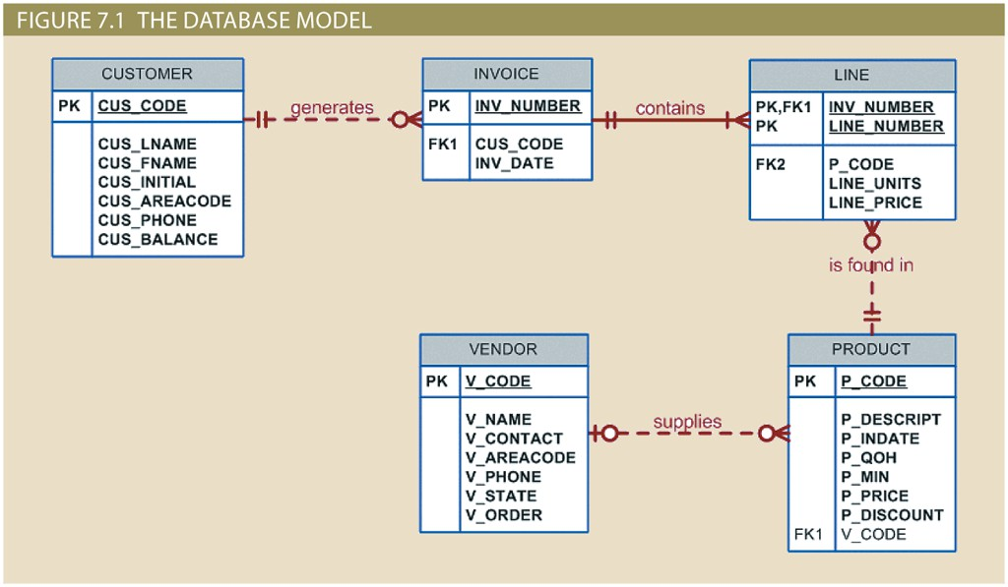
The Database Model

Slide 8
Basic SELECT Queries
Each clause in a SELECT query performs a specific function
  SELECT: specifies the attributes to be returned by the query
  FROM: specifies the table(s) from which the data will be retrieved
  WHERE: filters the rows of data based on provided criteria
  GROUP BY: groups the rows of data into collections based on sharing the same values in one or more attributes
  HAVING: filters the groups formed in the GROUP BY clause based on provided criteria
  ORDER BY: sorts the final query result rows in ascending or descending order based on the values of one or more attributes
SQL commands can be grouped together on a single line
  Complex command sequences are best shown on separate lines, with space between the SQL command and the command’s components

Slide 9
SELECT Statement Options (1 of 7)
The SELECT query specifies the columns to be retrieved as a column list
  Syntax:
  SELECT columnlist
  FROM tablelist;
  The columnlist represents one or more attributes, separated by commas
  A wildcard character is a symbol that can be used as a general substitute for other characters or commands
Using column aliases
  Alternative name for a column or table in a SQL statement
Using computed columns
  Computed column (also called a calculated column) represents a derived attribute
Arithmetic operators: the rule of precedence
  Rules that establish the order in which computations are completed

Slide 10
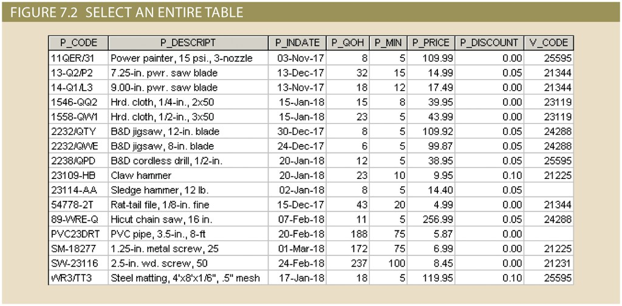
SELECT Statement Options (2 of 7)

Slide 11
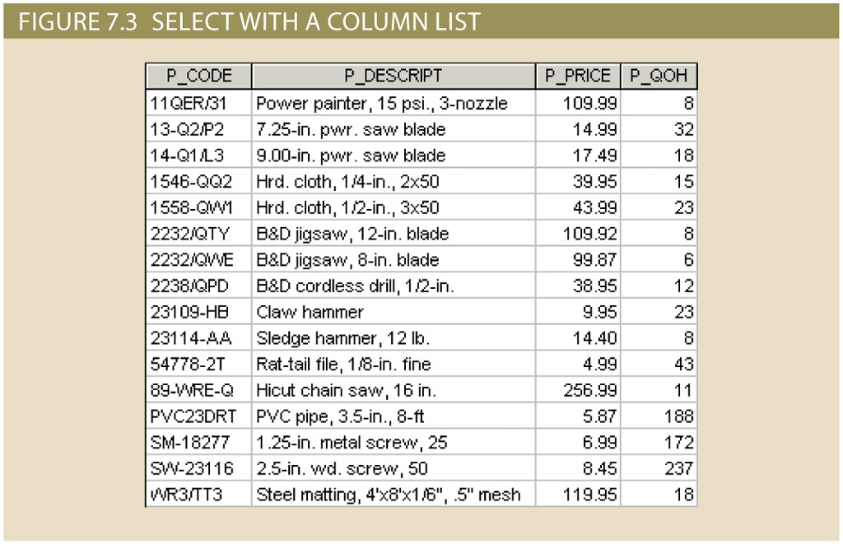
SELECT Statement Options (3 of 7)

Slide 12
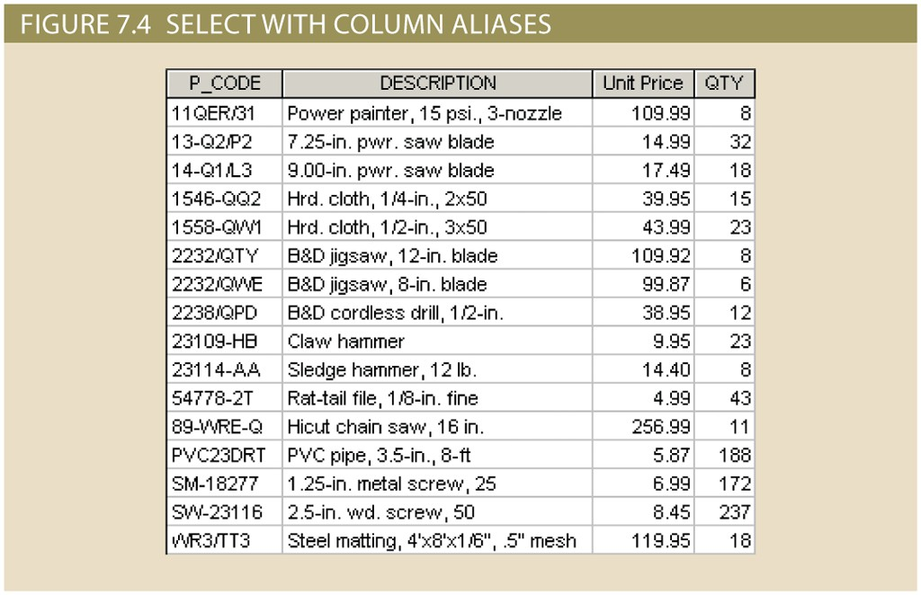
SELECT Statement Options (4 of 7)

Slide 13
SELECT Statement Options (5 of 7)
Table 7.4: The Arithmetic Operators
Operator | Description
+ | Add
- | Subtract
* | Multiply
/ | Divide
^ | Raise to the power of (some applications use ** instead of ^)

Slide 14
SELECT Statement Options (6 of 7)
Date arithmetic
  Values are stored as a number of days; it is possible to perform date arithmetic in a query
Listing unique values
  SQL’s DISTINCT clause produces a list of only those values that are different from one another
  Command example:
    SELECT DISTINCT V_CODE
    FROM PRODUCT;

Slide 15
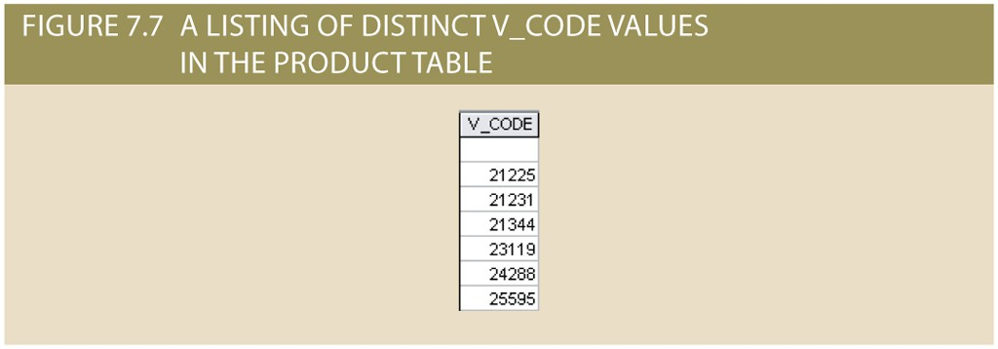
SELECT Statement Options (7 of 7)

Slide 16
FROM Clause Options (1 of 6)
FROM clause of the query specifies the table or tables from which the data is to be retrieved
  Inner joins return only rows from the tables that match on a common value
  Outer joins return the same matched rows as the inner join, plus unmatched rows from one table or the other
Natural join returns all rows with matching values in the matching columns and eliminates duplicate columns
  Determines the common attribute(s) by looking for attributes with identical names and compatible data types
  Selects only the rows with common values in the common attribute(s)
  If there are no common attributes, returns the relational product of the two tables
  Syntax:
    SELECT column-list FROM table1 NATURAL JOIN table2

Slide 17
FROM Clause Options (2 of 6)
Table 7.5 Creating Links through Foreign Keys
Table | Attributes To Be Shown | Linking Attribute
PRODUCT | P_DESCRIPT, P_PRICE | V_CODE
VENDOR | V_NAME, V_CONTACT, V_AREACODE, V_PHONE | V_CODE

Slide 18
FROM Clause Options (3 of 6)
JOIN USING syntax
  Returns only the rows with matching values in the column indicated in the USING clause—and that column must exist in both tables
  Syntax:
    SELECT column-list FROM table1 JOIN table2 USING (common-column)
JOIN ON syntax
  Express a join when the tables have no common attribute names
  Query returns only the rows that meet the indicated join condition
  Syntax:
    SELECT column-list FROM table1 JOIN table2 ON join-condition
Common attribute names
  Most common cause of duplicate column names is the existence of a foreign key

Slide 19
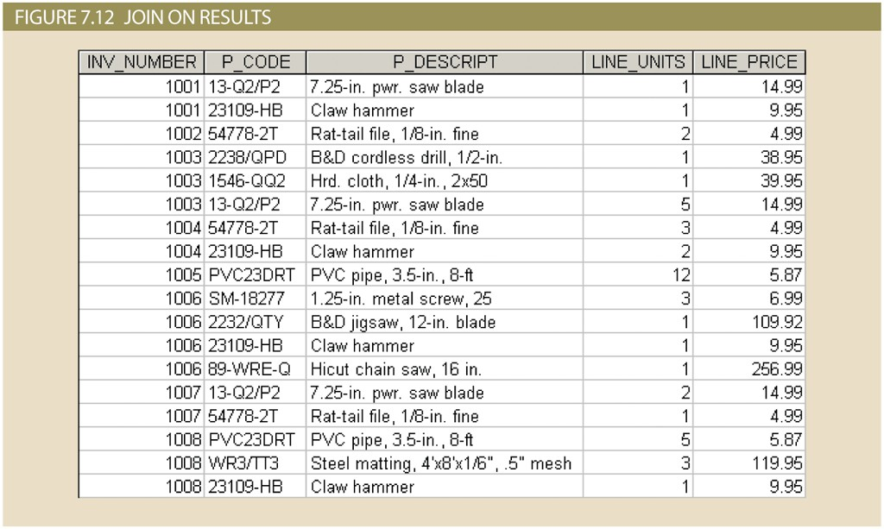
FROM Clause Options (4 of 6)

Slide 20
FROM Clause Options (5 of 6)
Outer joins
  Returns not only the rows matching the join condition (rows with matching values in the common columns) and returns the rows with unmatched values
  ANSI standard defines three types of outer joins: left, right, and full
Cross join
  Performs a relational product (also known as the Cartesian product) of two tables
Joining tables with an alias
  An alias may be used to identify the source table from which the data is taken
  The ability to specify a table alias is very useful
    Using a table alias allows the database programmer to improve the maintainability of the code by using a table alias that is descriptive of what data the table is providing within the query
Recursive joins
  Recursive query: joins a table to itself

Slide 21
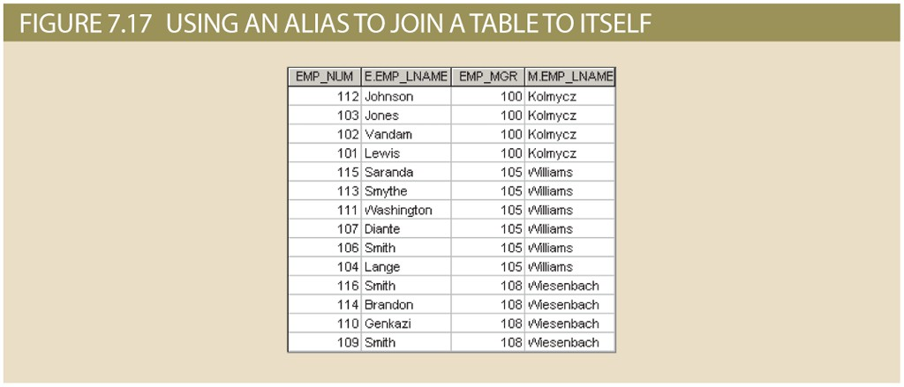
FROM Clause Options (6 of 6)

Slide 22
ORDER BY Clause Options (1 of 2)
ORDER BY clause is especially useful when the listing order is important
  Syntax:
    SELECT columnlist
    FROM tablelist
    [ORDER BY columnlist [ASC|DESC] ];
  Cascading order sequence
    1. ORDER BY last name
    2. Within matching last names, ORDER BY first name
    3. Within matching first and last names, ORDER BY middle initial

Slide 23
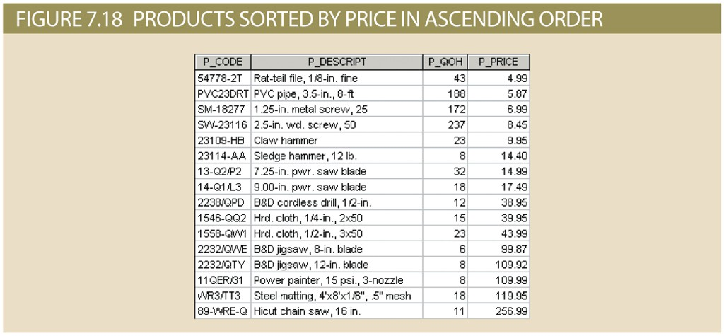
ORDER BY Clause Options (2 of 2)

Slide 24
WHERE Clause Options (1 of 4)
Selecting rows with conditional restrictions
  WHERE clause is used to add conditional restrictions to the SELECT statement that limit the rows returned by the query
  Syntax:
    SELECT columnlist
    FROM tablelist
    [WHERE conditionlist ]
    [ORDER BY columnlist [ASC | DESC] ];
Using comparison operators on character attributes
  May be used to place restrictions on character-based attributes
Using comparison operators on dates
  Date procedures are often more software-specific than other SQL procedures

Slide 25
WHERE Clause Options (2 of 4)
Table 7.6 Comparison Operators
Symbol | Meaning
= | Equal to
< | Less than
<= | Less than or equal to
> | Greater than
>= | Greater than or equal to
<> or != | Not equal to

Slide 26
WHERE Clause Options (3 of 4)
Selecting rows with conditional restrictions
  WHERE clause is used to add conditional restrictions to the SELECT statement that limit the rows returned by the query
  Syntax:
    SELECT columnlist
    FROM tablelist
    [WHERE conditionlist ]
    [ORDER BY columnlist [ASC | DESC] ];
Using comparison operators on character attributes
  May be used to place restrictions on character-based attributes
Using comparison operators on dates
  Date procedures are often more software-specific than other SQL procedures

Slide 27
WHERE Clause Options (4 of 4)
Logical operators: AND, OR, and NOT
  SQL allows you to include multiple conditions in a query through the use of these logical operators
  Boolean algebra is dedicated to the use of logical operators
Old-style joins
  Generally not recommended
    Make complex queries more difficult to maintain
    Susceptible to undetected errors
Special operators
  BETWEEN
  IN
  LIKE
  IS NULL
  NOT

Slide 28
Aggregate Processing (1 of 3)
Takes a collection of rows and reduces it to a single row
  SQL provides useful aggregate functions that count, find minimum and maximum values, calculate averages, etc.
Aggregate functions
  Count
  MIN and MAX
  SUM and AVG
Grouping data
  GROUP BY clause syntax:
    SELECT columnlist
    FROM tablelist
    [WHERE conditionlist ]
    [GROUP BY columnlist ]
    [ORDER BY columnlist [ASC | DESC] ];

Slide 29
Aggregate Processing (2 of 3)
Table 7.7 Some Basic SQL Aggregate Functions
Function | Output
COUNT | The number of rows containing non-null values
MIN | The minimum attribute value encountered in a given column
MAX | The maximum attribute value encountered in a given column
SUM | The sum of all values for a given column
AVG | The arithmetic mean (average) for a specified column

Slide 30
Aggregate Processing (3 of 3)
HAVING clause
  Operates very much like the WHERE clause in the SELECT statement
  HAVING clause is applied to the output of a GROUP BY operation
  Syntax:
    SELECT columnlist
    FROM tablelist
    [WHERE conditionlist ]
    [GROUP BY columnlist ]
    [HAVING conditionlist ]
    [ORDER BY columnlist [ASC | DESC] ];

Slide 31
Subqueries (1 of 3)
Key characteristics
  A subquery is a query (SELECT statement) inside another query
  A subquery is normally expressed inside parentheses
  The first query in the SQL statement is known as the outer query
  The query inside the SQL statement is known as the inner query
  The inner query is executed first
  The output of an inner query is used as the input for the outer query
  The entire SQL statement is sometimes referred to as a nested query
Subquery can return one or more values
  One single value (one column and one row)
  A list of values (one column and multiple rows)
  A virtual table (multicolumn, multirow set of values)

Slide 32
Subqueries (2 of 3)
WHERE subqueries
  Most common type of subquery uses an inner SELECT subquery on the right side of a WHERE comparison expression
IN subqueries
  IN operator: used to compare a single attribute to a list of values
  IN subquery: values are not known beforehand, but can be derived using a query
HAVING subqueries
  HAVING clause: used to restrict the output of a GROUP BY query by applying conditional criteria to the grouped rows
Multirow subquery operators: ALL and ANY
  ALL operator compares a single value with a list of values returned by the first subquery using a comparison operator other than equals
  ANY operator compares a single value to a list of values and select only the rows greater than or less than any value in the list

Slide 33
Subqueries (3 of 3)
FROM subqueries
  FROM clause specifies the table(s) from which the data will be drawn
Attribute list subqueries
  Inline subquery: subquery expression
    Example: can be used to list the difference between each product’s price and the average product price
Correlated subquery
  Executes once for each row in the outer query
  Inner query is related to the outer query; the inner query references a column of the outer subquery
  Can also be used with the EXISTS special operator
    Can be used whenever there is a requirement to execute a command based on the result of another query
    Can be used with uncorrelated subqueries, but it is almost always used with correlated subqueries

Slide 34
SQL Functions
SQL functions are very useful tools
  Many types
Date and time functions
  All date functions take one parameter of a date or character data type and return a value; refer to Table 7.10
Numeric functions
  Can be grouped in many different ways, such as algebraic, trigonometric, and logarithmic; refer to Table 7.11
String functions
  Among the most-used functions in programming; refer to Table 7.12
Conversion functions
  Allow you to take a value of a given data type and convert it to the equivalent value in another data type; refer to Table 7.13

Slide 35
Relational Set Operators (1 of 2)
UNION
  Combines rows from two or more queries without including duplicate rows
  Syntax:
    query UNION query
UNION ALL
  Used to produce a relation that retains the duplicate rows
  Used to unite more than just two queries
INTERSECT
  Can be used to combine rows from two queries, returning only the rows that appear in both sets
  Syntax:
    query INTERSECT query

Slide 36
Relational Set Operators (2 of 2)
EXCEPT (MINUS)
  Combines rows from two queries and returns only the rows that appear in the first set but not in the second
  Syntax:
    query EXCEPT query
    and
    query MINUS query
Syntax alternatives
  Alternative syntax used to achieve the same output

Slide 37
Crafting SELECT Queries (1 of 2)
Know your data
  The importance of understanding the data model that you are working in cannot be overstated
  Real-world databases are messy; most database systems remain in service in an organization for decades
Know the problem
  Understand the question you are attempting to answer
  Information reporting requests will come from a range of sources; may be one-time events or ongoing operations within an application

Slide 38
Crafting SELECT Queries (2 of 2)
Build one clause at a time
  FROM
  WHERE
  GROUP BY
  HAVING
  SELECT
  ORDER BY

Slide 39
Summary (1 of 2)
SQL commands can be divided into two overall categories: data definition language (DDL) commands and data manipulation language (DML) commands
The ANSI standard data types are supported by all RDBMS vendors in different ways
  The basic data types are NUMBER, NUMERIC, INTEGER, CHAR, VARCHAR, and DATE
The SELECT statement is the main data retrieval command in SQL
The column list represents one or more column names separated by commas
Operations that join tables can be classified as inner joins and outer joins
A natural join returns all rows with matching values in the matching columns and eliminates duplicate columns
Joins may use keywords such as USING and ON
The ORDER BY clause is used to sort the output of a SELECT statement

Slide 40
Summary (2 of 2)
The WHERE clause can be used with the SELECT, UPDATE, and DELETE statements to restrict the rows affected by the DDL command
Aggregate functions (COUNT, MIN, MAX, and AVG) are special functions that perform arithmetic computations over a set of rows
Subqueries and correlated queries are used when it is necessary to process data based on other processed data
Most subqueries are executed in a serial fashion
SQL functions are used to extract or transform data
SQL provides relational set operators to combine the output of two queries to generate a new relation
Crafting effective and efficient SQL queries requires a great deal of skill

